Slide 1
Optical communications and data networks (EENGM2001)
Siddarth K Joshi

Slide 2
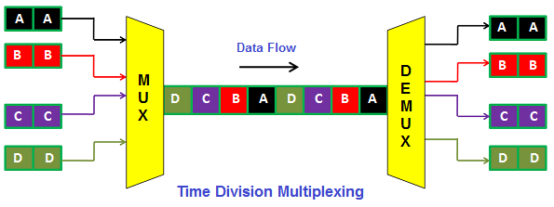
Multiplexing
Multiplexing:
Wavelength
Time
Spatial mode
Polarisation
Multiplexing: The process of mixing various data streams together into the same optical fibre
Remember the optical interleaver?

Slide 3
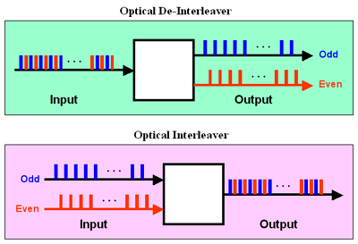
Optical Interleaver: Recap
Combines pulses with different timing into a single output stream
(a type of multiplexing)
Compresses the wavelength bandwidth of both signals to increase the capacity of the channel

Slide 4
Wavelength multiplexing
Learning outcomes
Why WDMs?
Types
Standards
Thin film WDMs
Arrayed waveguide gratings
Add drop WDMs
Reconfigurable optical add-drop multiplexer
WDM topologies
Practical examples
Explain WDMs in modern networks
Calculate bandwidth and number of channels needed for different topologies

Slide 5
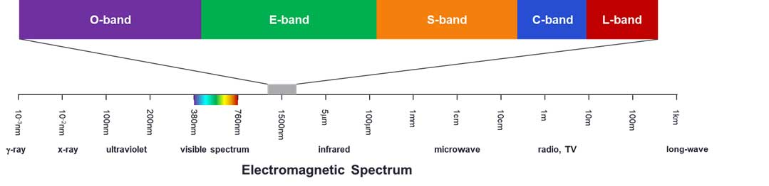
Wavelength multiplexing
Wavelength: Colour of the light used
Most modern optical communications

Slide 6
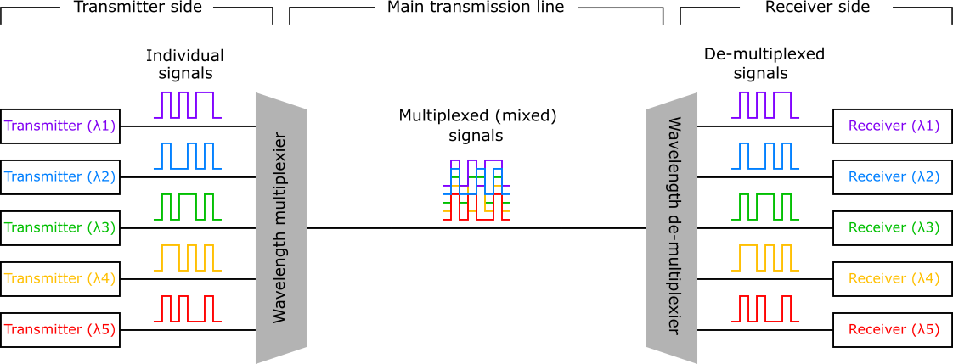
Wavelength multiplexing

Slide 7
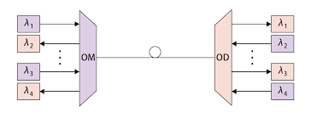
Wavelength multiplexing
Transmitter
Receiver
Bi-directional communication also possible.
WDM filters work in both directions
Mux/Demux logical names

Slide 8
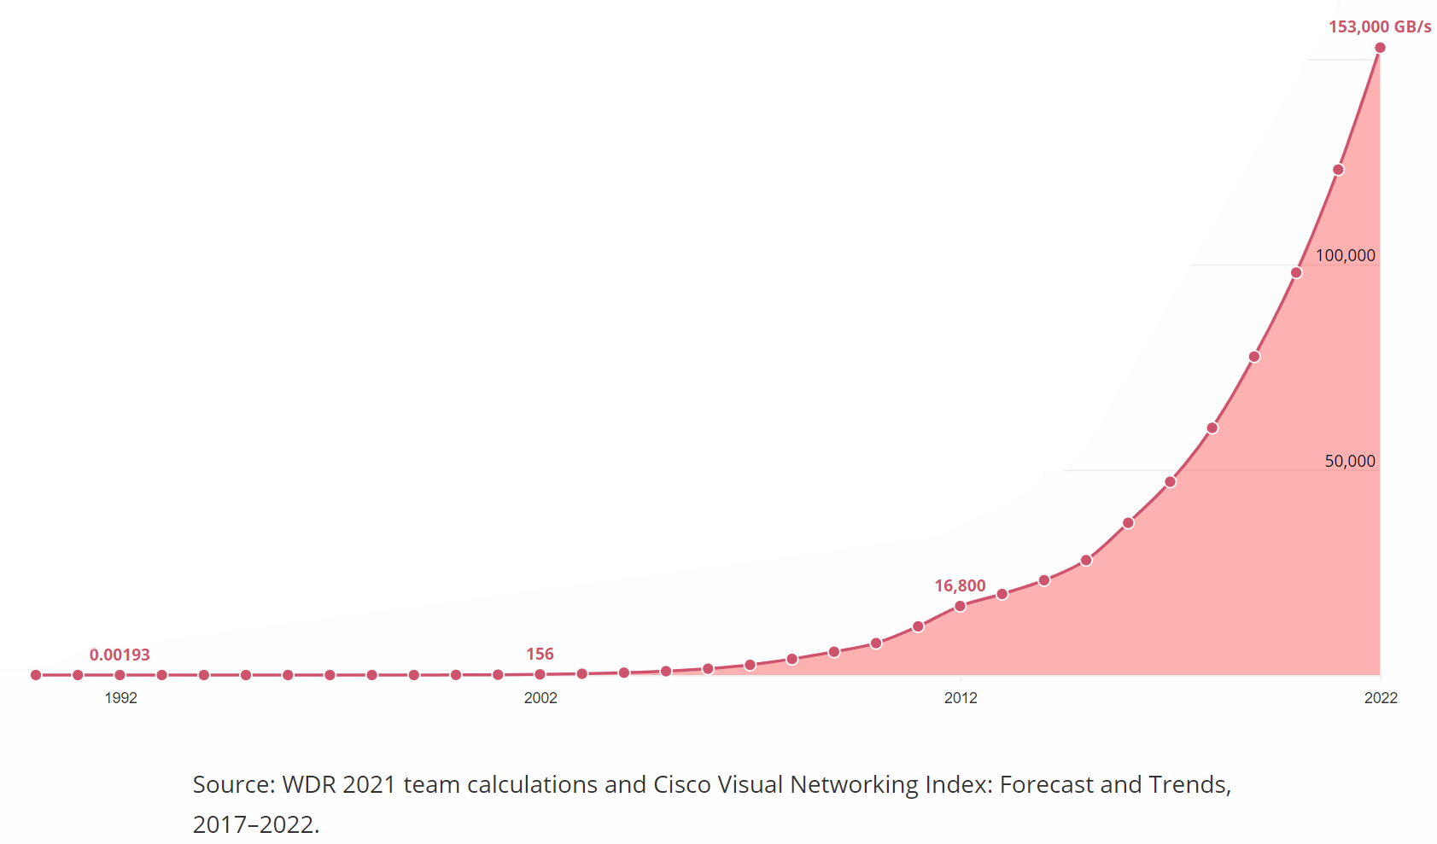
Wavelength multiplexing
Traffic grows much faster than new long-distance cables.
Need to increase capacity of each cable!

Slide 9
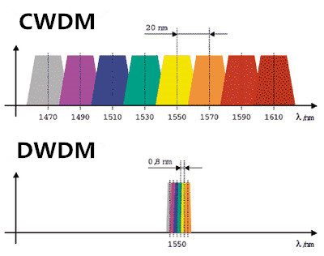
Wavelength multiplexing
Coarse WDM
Dense WDM

Slide 10
Wavelength multiplexing
CWDM | DWDM
Cheaper | More expensive
Lasers not stabilised | Stabilised to stay within bandwidth
≈ 10Gb/s | Up to 1 Tbps
< 80 Km | Ultra long reach
18 channels in O to L bands | 45 channels in C band alone

Slide 11
Wavelength multiplexing
CWDM | DWDM
Cheaper | More expensive
Lasers not stabilised | Stabilised to stay within bandwidth
≈ 10Gb/s | Up to 1 Tbps
< 80 Km | Ultra long reach
18 channels in O to L bands | 45 channels in C band alone
Large channel bandwidth
Fast Modulation
Hard to modulate faster than 40 Gbps

Slide 12
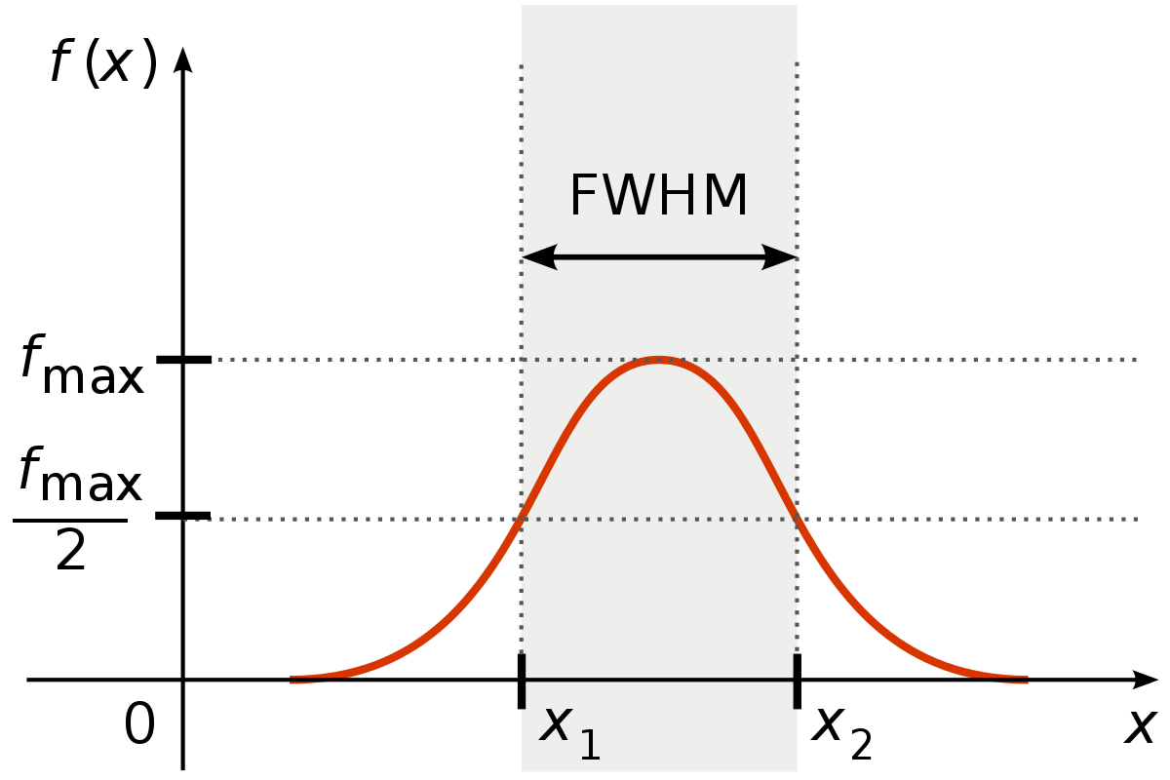
Wavelength multiplexing
Power
Bandwidth
Δλ = |λ₁ – λ₂| in terms of wavelength
Δf = |f₁ – f₂| in terms of frequency
Bandwidth
P
P
-3 dB
λ₁
λ₂

Slide 13
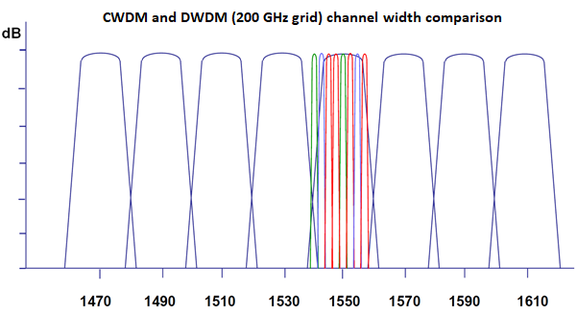


Wavelength multiplexing
Typically filters have a top hat profile not gaussian
Bandwidth defined in the same way
$$Δf=\frac{ΔλC}{λ^{2}}$$
$$Δλ=\frac{ΔfC}{f^{2}}$$

Slide 14
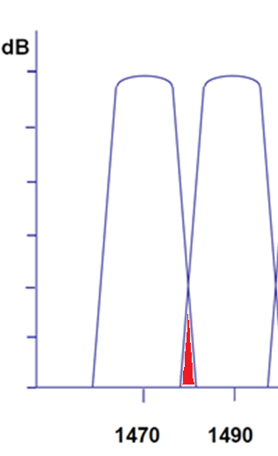
Wavelength multiplexing
Cross talk: Signal from one multiplexed channel enters into another channel causing an increase in noise.
Cross talk

Slide 15
Wavelength multiplexing
Large channel bandwidth
More Cross talk
More noise
Shorter link distances

Slide 16
Wavelength multiplexing
ITU: International Telecommunication Union
Standards specify the central wavelength and Spacing for both CWDM and DWDM

Slide 17
Wavelength multiplexing
Spacing
0
Bandwidth is not the same as spacing
-3
-6
Bandwidth
-9
-12
-15

Slide 18
Wavelength multiplexing
ITU grid for CWDM:
Spacing = 20nm
Center wavelengths 1270 nm, 1290 nm, 1310 nm, ... , 1590 nm, 1610 nm

Slide 19
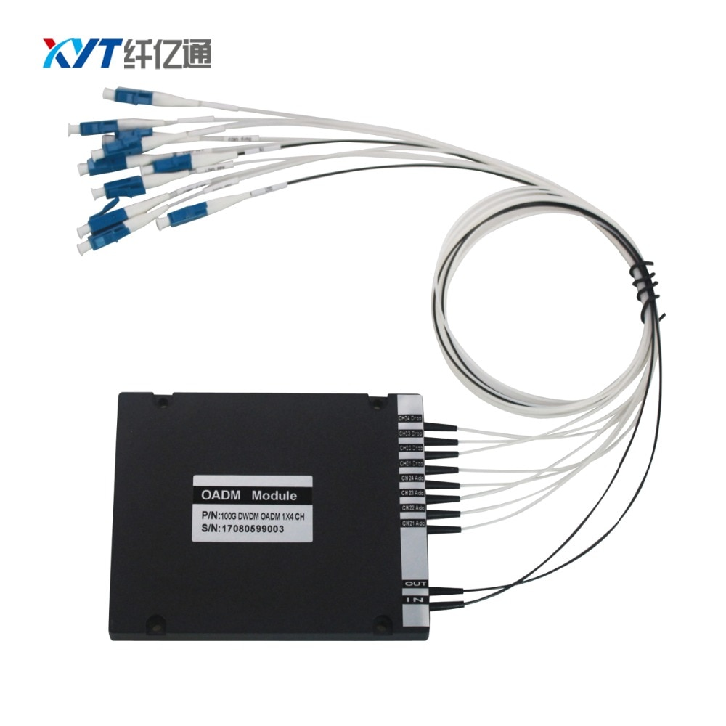
Wavelength multiplexing
ITU grid for DWDM:
Spacing = 100 GHz ≈ 0.8 nm
Channel number | Central Frequency (THz) | Central wavelength (nm)
1 | 190.1 | 1577.03
2 | 190.2 | 1576.20
3 | 190.3 | 1575.37
…. | …
72 | 197.2 | 1520.25

Slide 20
Wavelength multiplexing
ITU grid for DWDM:
Old:
Spacing = 200 GHz ≈ 1.6 nm
Use only even or odd channel numbers
Current:
Spacing = 100 GHz ≈ 0.8 nm
Future:
Spacing = 50 GHz ≈ 0.4 nm
Use fractional channel numbers
Channel number | Central Frequency (THz) | Central wavelength (nm)
1 | 190.1 | 1577.03
1.5 | 190.15 | 1576.61
2 | 190.2 | 1576.20

Slide 21
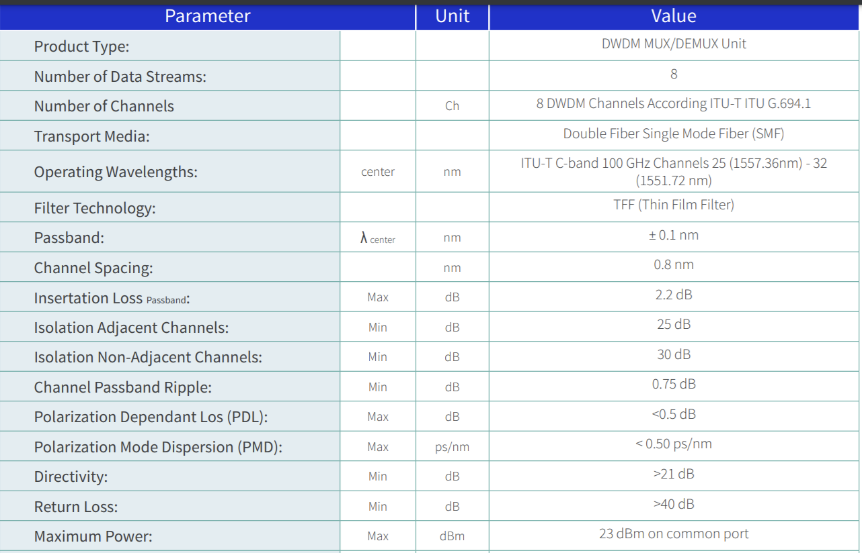
Wavelength multiplexing
Cross talk =
Input power – isolation – directivity

Slide 22
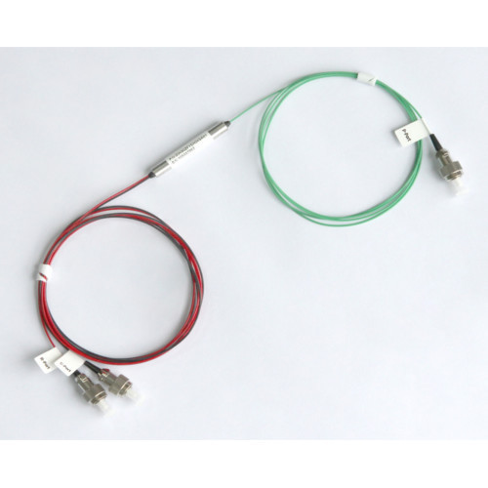
Wavelength multiplexing
Add drop WDM (aka single channel)
Common
Reject
WDM
Pass

Slide 23
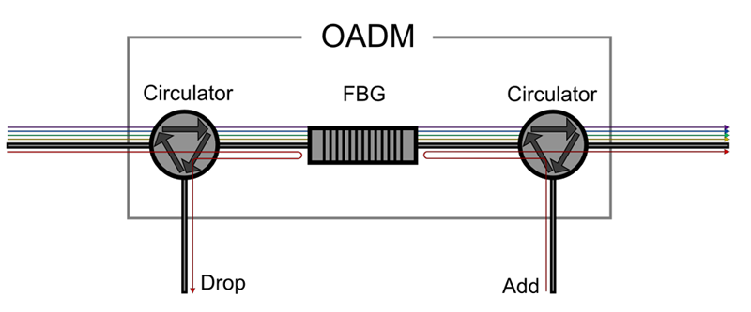
Wavelength multiplexing
Add drop WDM (aka single channel)

Slide 24
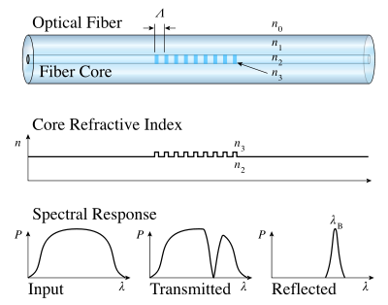
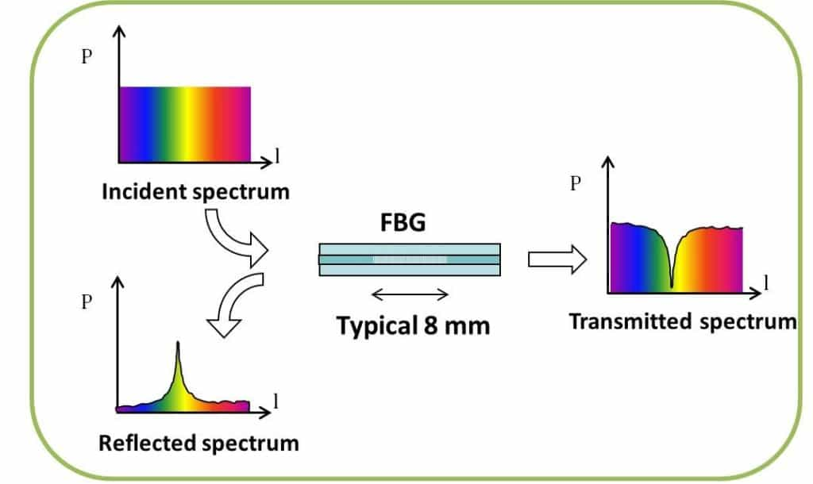
Fibre Bragg Gratting
λ_{Bragg} = 2nΛ

Slide 25
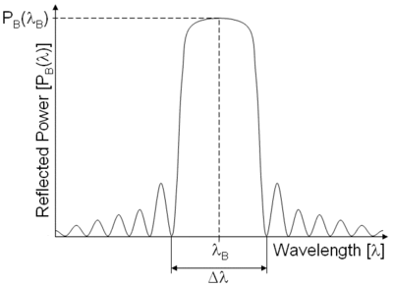
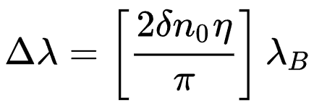
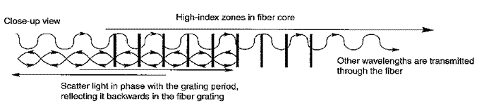
Fibre Bragg Grating
λ_{Bragg} = 2nΛ

Slide 26
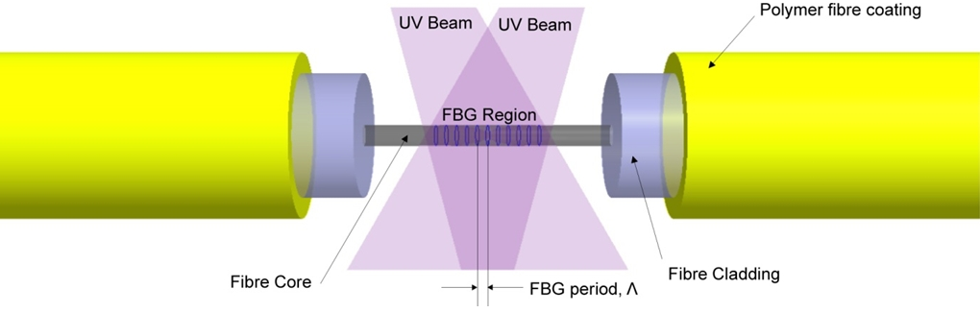
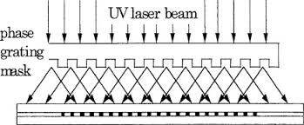
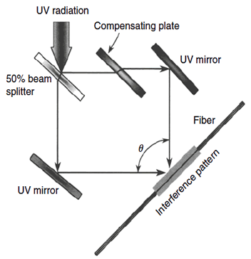
Fibre Bragg Grating

Slide 27
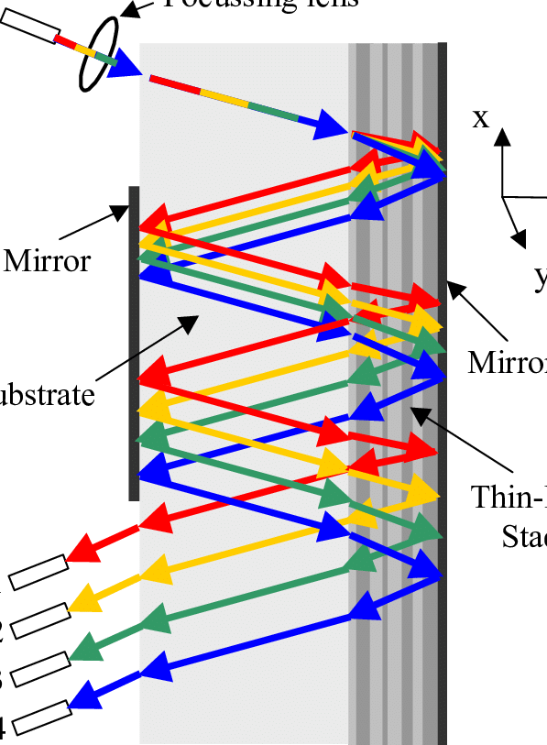
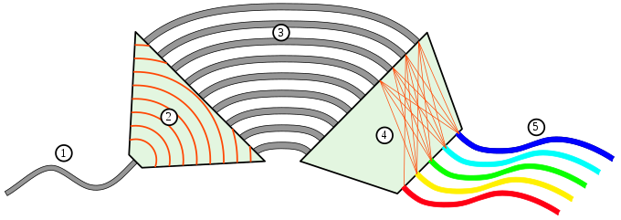
WDM technologies
Cascading FBGs is not the best.
Thin Film | Arrayed Wave Guide
Good for few channels | Lower loss for many channels
Similar to Fabry–Pérot | Interferometric
Built by Vapour deposition or sputtering | Etched, optically or via CMOS

Slide 28
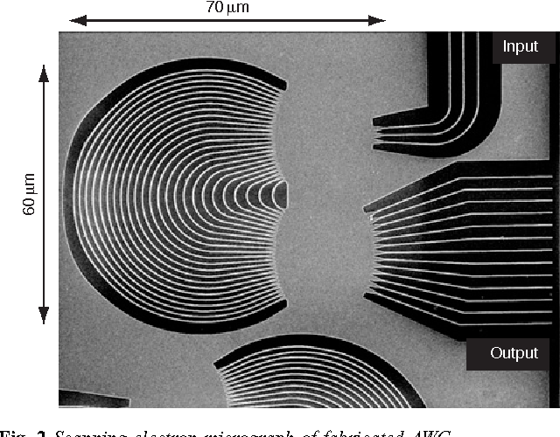
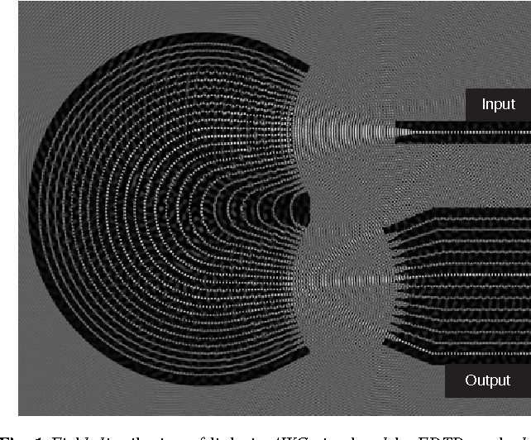
AWG

Slide 29
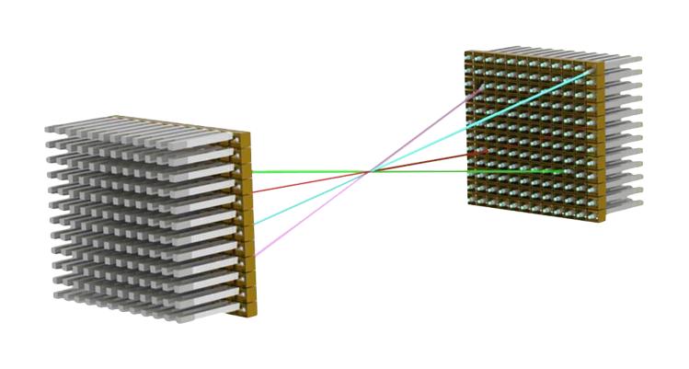
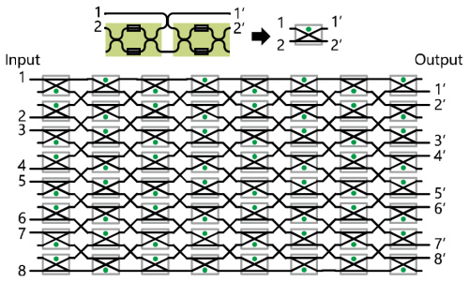
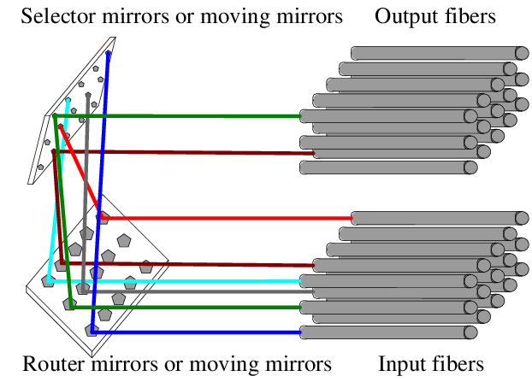
Optical Switch
Optical path switching (or optical matrix switching), Optical transistors and opto-mechanical switches are often confused.
Mems or Piezo based
Interferometer based photonic path switch

Slide 30
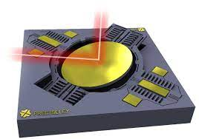
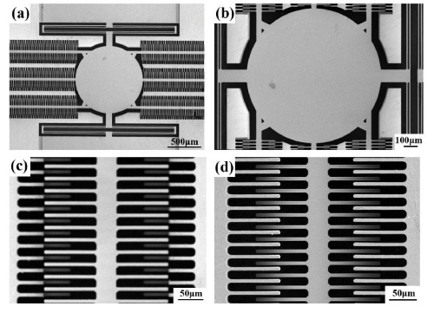
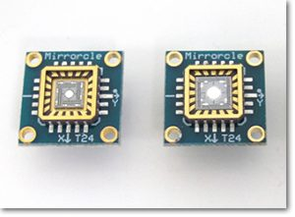
Mems
Mems =micro-electromechanical system
Driven by magnetic fields or electrostatic fields
Difficult to damp out oscillations at high speed
Sub um prescision

Slide 31
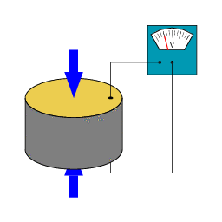
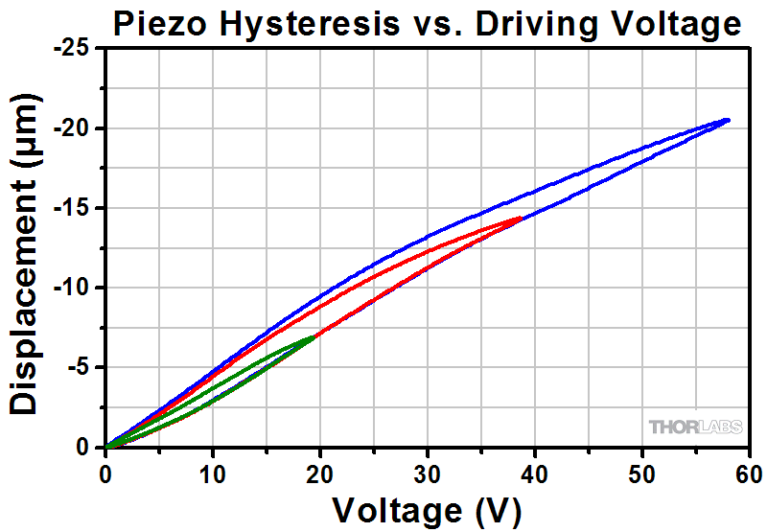
Piezo electric effect
Apply voltage to change crystal length.
Needs high voltage for even a few um
Sub nm precision

Slide 32
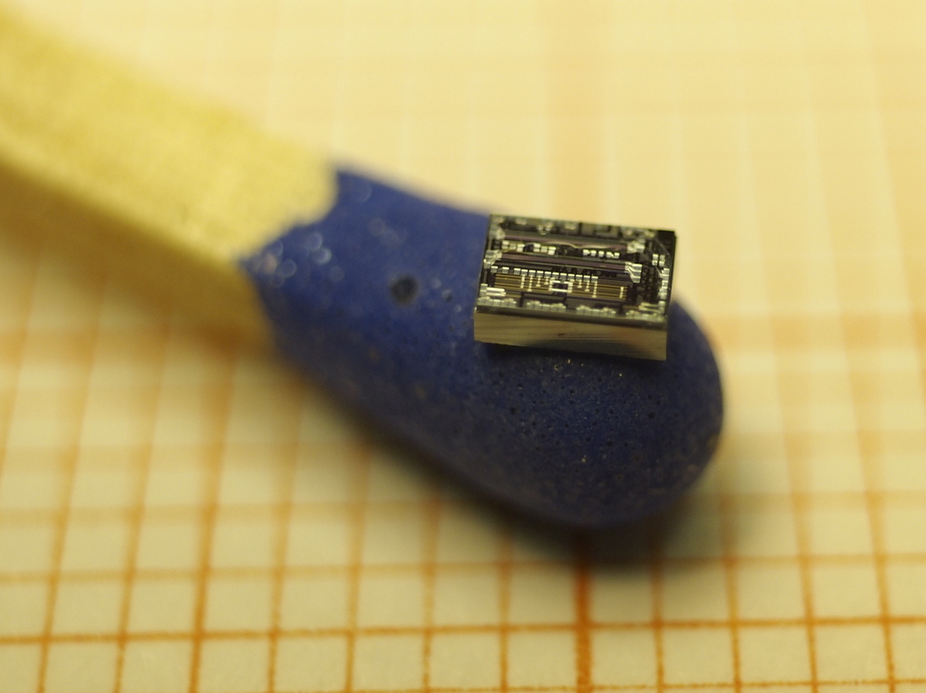
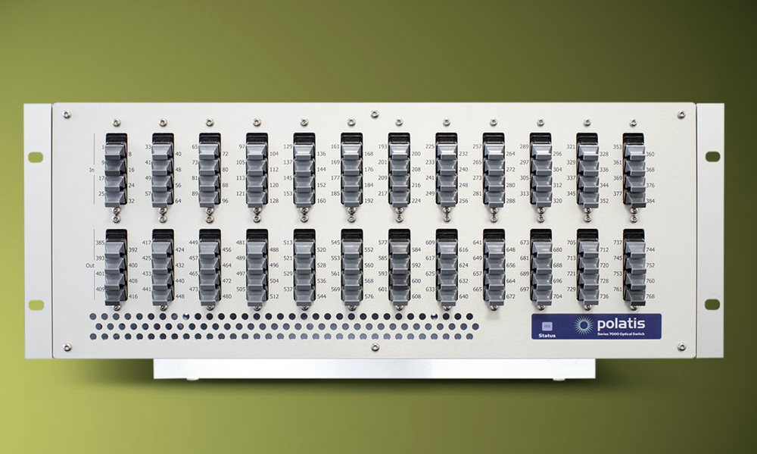

Optical path switches
Interferometric | MEMS/Piezo
Good for few channels | Lower loss for many channels
Fast (>MHz) | Slow (<kHz)
Tiny but polarisation dependent | Large but polarisation independent
Can act as a BS (i.e. 1 to many) | 1 to 1 switching only
Optical transistors are fascinating! More about how they can build a 1000 times faster computer here
https://spectrum.ieee.org/optical-switch-1000x-faster-transistors

Slide 33
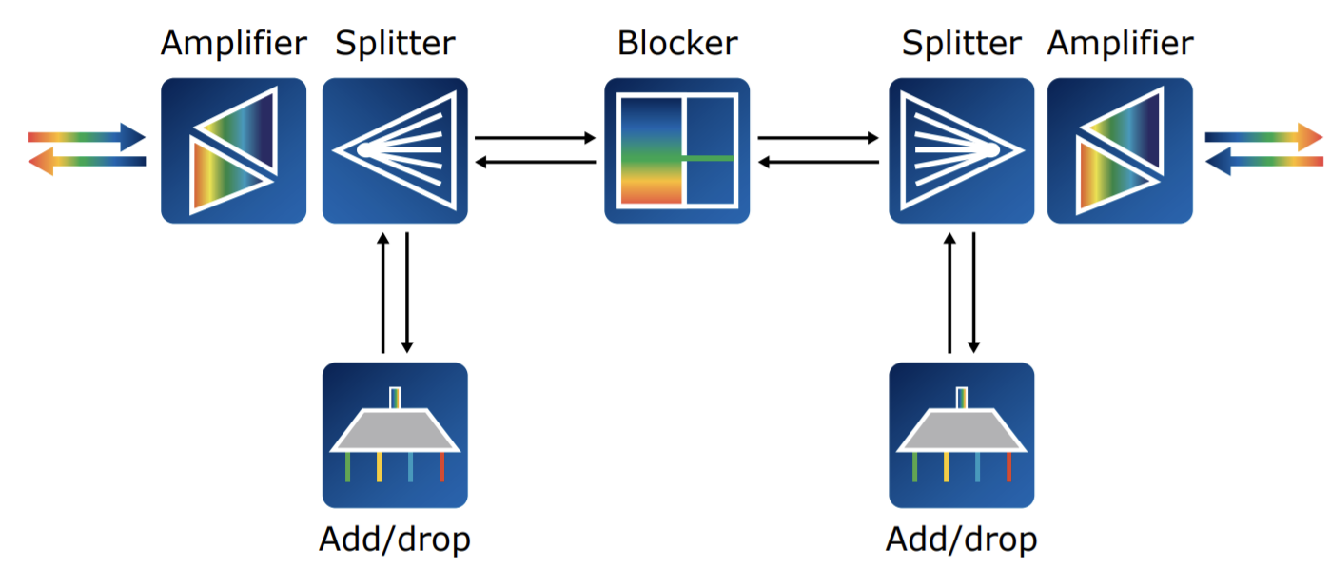
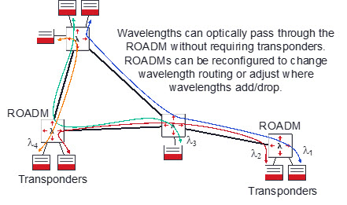
ROADM
Reconfigurable Optical Add-Drop Multiplexer:
add, block, pass or redirect signals

Slide 34
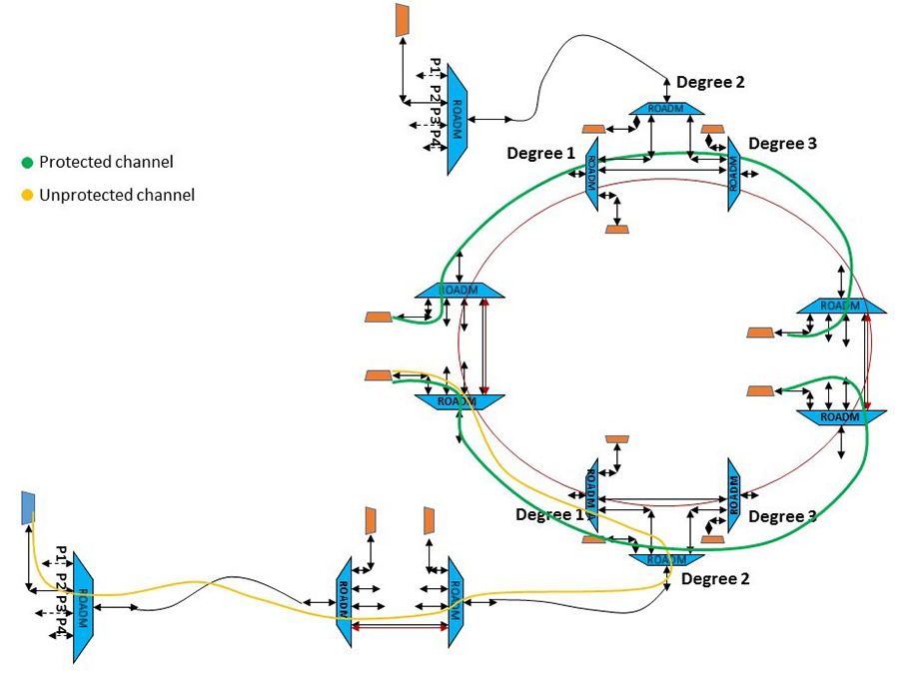
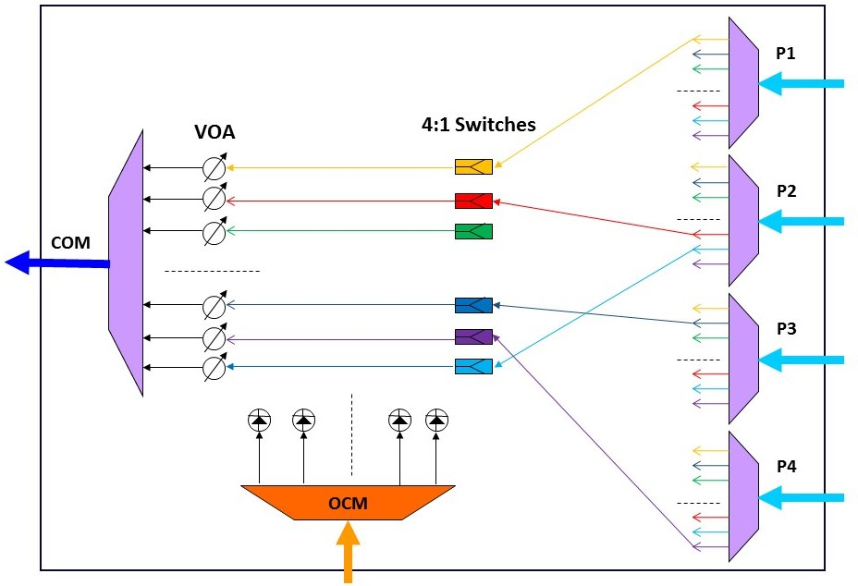
ROADM
This is how we start to build real networks. More info EENGM0003 Optical Networks by George Kanellos

Slide 35
Further reading
Chapter 12: Optical Communications Essentials Gerd Keiser, ISBN 0-07-141204-2
Section 15.2.3 and section 15.4: Optical fibre communications Principles and Practice Third edition John M. Senior ISBN: 978-0-13-032681-2

Slide 36
Problems
Given the following constraints, what is the longest distance over which an NRZ OOK protocol can have at least 1Gbps of data rate.
Up to 20 EDFAs each with:
Min input power = -20dBm
Max input power = 0dBm
Tuneable gain <=40 dBm
Noise figure = 3.8dBm
1 units of OOK transmitters
with 10 dBm transmit power, 1 Gbaud/s and a transmit noise of -20dBm
1unit of OOK receivers:
0.4A/W responsivity 0.5nA of dark current and 5E-12 W/Sqrt(Hz) NEP, max bandwidth is 10GHz
Optical fibre:
SM, 0.2dB/Km,
No loss when connecting any other components.
Assume that the EDFAs are equally spaced and there is no additional EDFA before the receiver. Further assume that the maximum desirable launch power is 10dBm.
Will adding more EDFAs help improve the distance?

Slide 37
Problems
Max launch power is 10 dBm and min receive power for next EDFA is -20dBm, So a max loss of 30dB is permitted.
At 0.2dB/km, we can have upto 150 km between EDFAs
With -20dBm of transmit noise, the best SNR of the transmitter becomes 10mW/10uW => SNR = 1,000 or 30dB.
When each EDFA has 3.8 dB Noise Factor. We can have int(30/3.8) = 7 EDFAs in the total length
150km*7 = 1050km
The 40dB gain of the EDFA is more than enough to boost the launch power back to 10dBm from -20dBm

Slide 38
Problems
But the detector is sensitive up to:
Total noise in detector: 0.5nA + Sqrt(Bw)* 5E-12*0.4. The bandwidth is 1 GHz (since that is the transmit bandwidth) =63.7nA.
To be detected the signal must be > noise. So we need a signal strength of 63.7nA/0.4A/W = 1.59E-7 nW = -37.9dBm or more.
That means an additional -37.9/0.2 = 189.5km of fibre would be ok.
Total length = 1050+189.5 = 1,239.5 km
Normally we would want a better SNR but if it is not specified we can go with the bare minimum of 1

Slide 39
Problems
Will adding more EDFAs help?
No. There is already too much noise from the EDFAs
If I could place Raman amplifiers with a gain of 15dB and effective NF of -1 along with each EDFA, how much longer could the total span be?

Slide 40
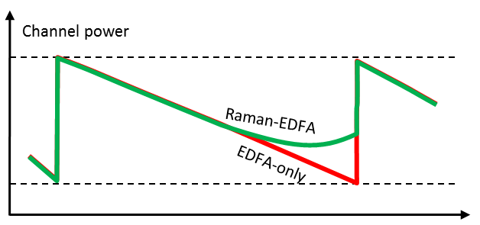
Problems
With a Raman amplifier in place, the power before the EDFA is increased by 15dB
So that’s an additional 15/0.2 = 75 km between each EDFA.
Additionally the Raman amplifier would reduce the NF of each EDFA by 1dB
When each Raman-EDFA pair has (3.8-1) dB Noise Factor. We can have int(30/2.8) = 10 Raman-EDFA pairs in the total length
So the total fibre distance can be 10*(150+75)+189.5 = 2439.5 km
Wow, almost double!

